Slide 1


Machine Learning in High Energy Physics: the Search for Vector-Like Quarks
Alex Stoken University of Arizona Class of 2019
Dr. Erich Varnes UA High Energy Physics Group, ATLAS Experiment
April 14, 2018 | NASA Space Grant Symposium | Tucson, AZ

Slide 2
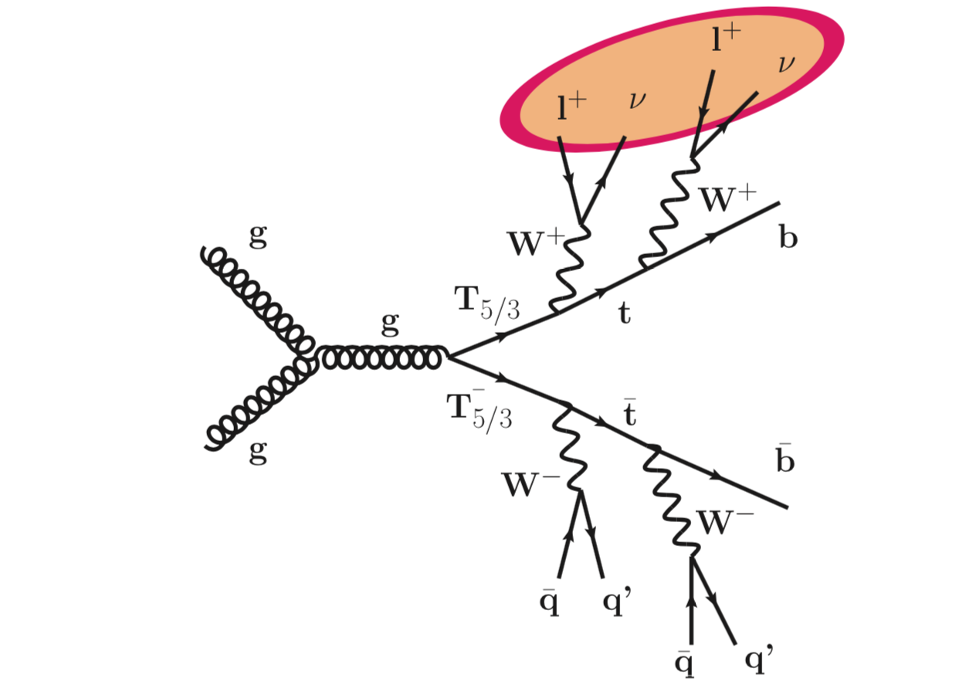
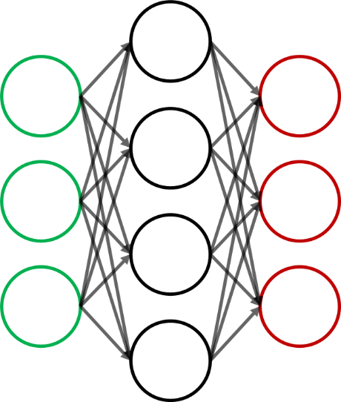

Terminology
Vector-Like Quarks (VLQ)
Predicted particle in many new physics theories
Machine Learning
Algorithmic “learning” from patterns and structures within datasets
INPUTS
OUTPUTS
LEARNING
Fig 1: Feynman diagram of VLQ pair production
Fig 2: Neural Network learning model
Notes:
Find pair production VLQ diagrams

Slide 3

Background: Searching for Particles

Slide 4
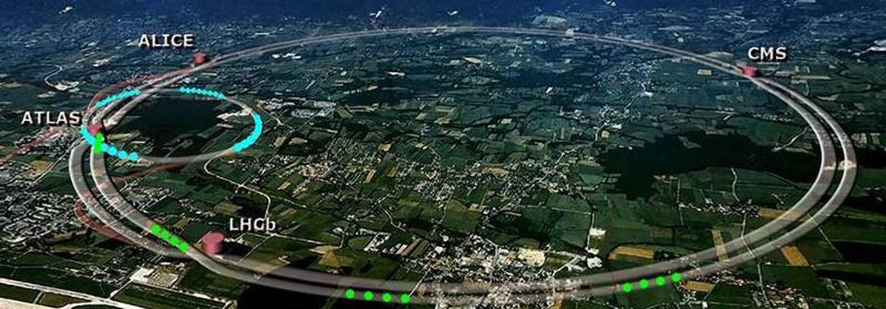
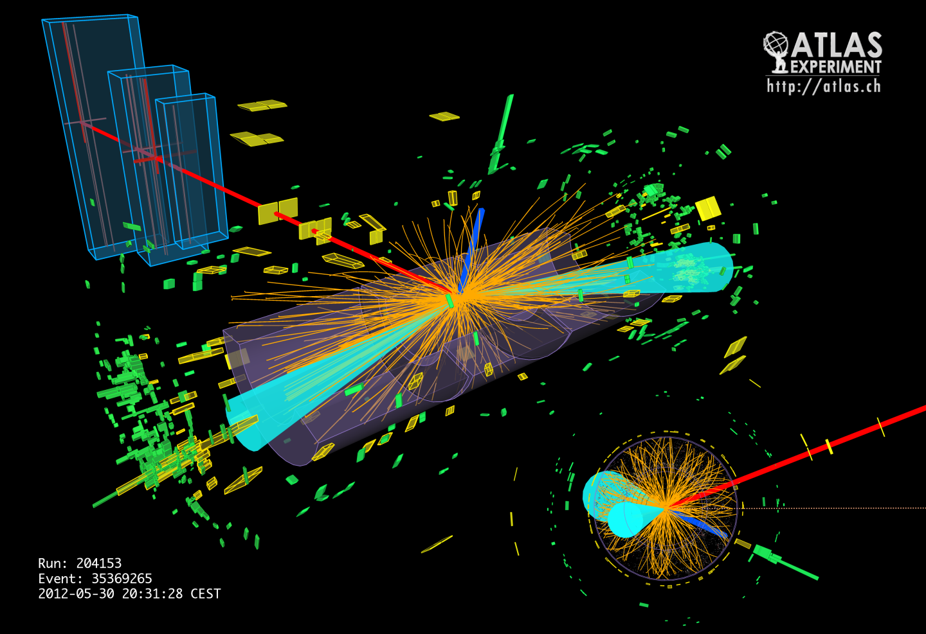
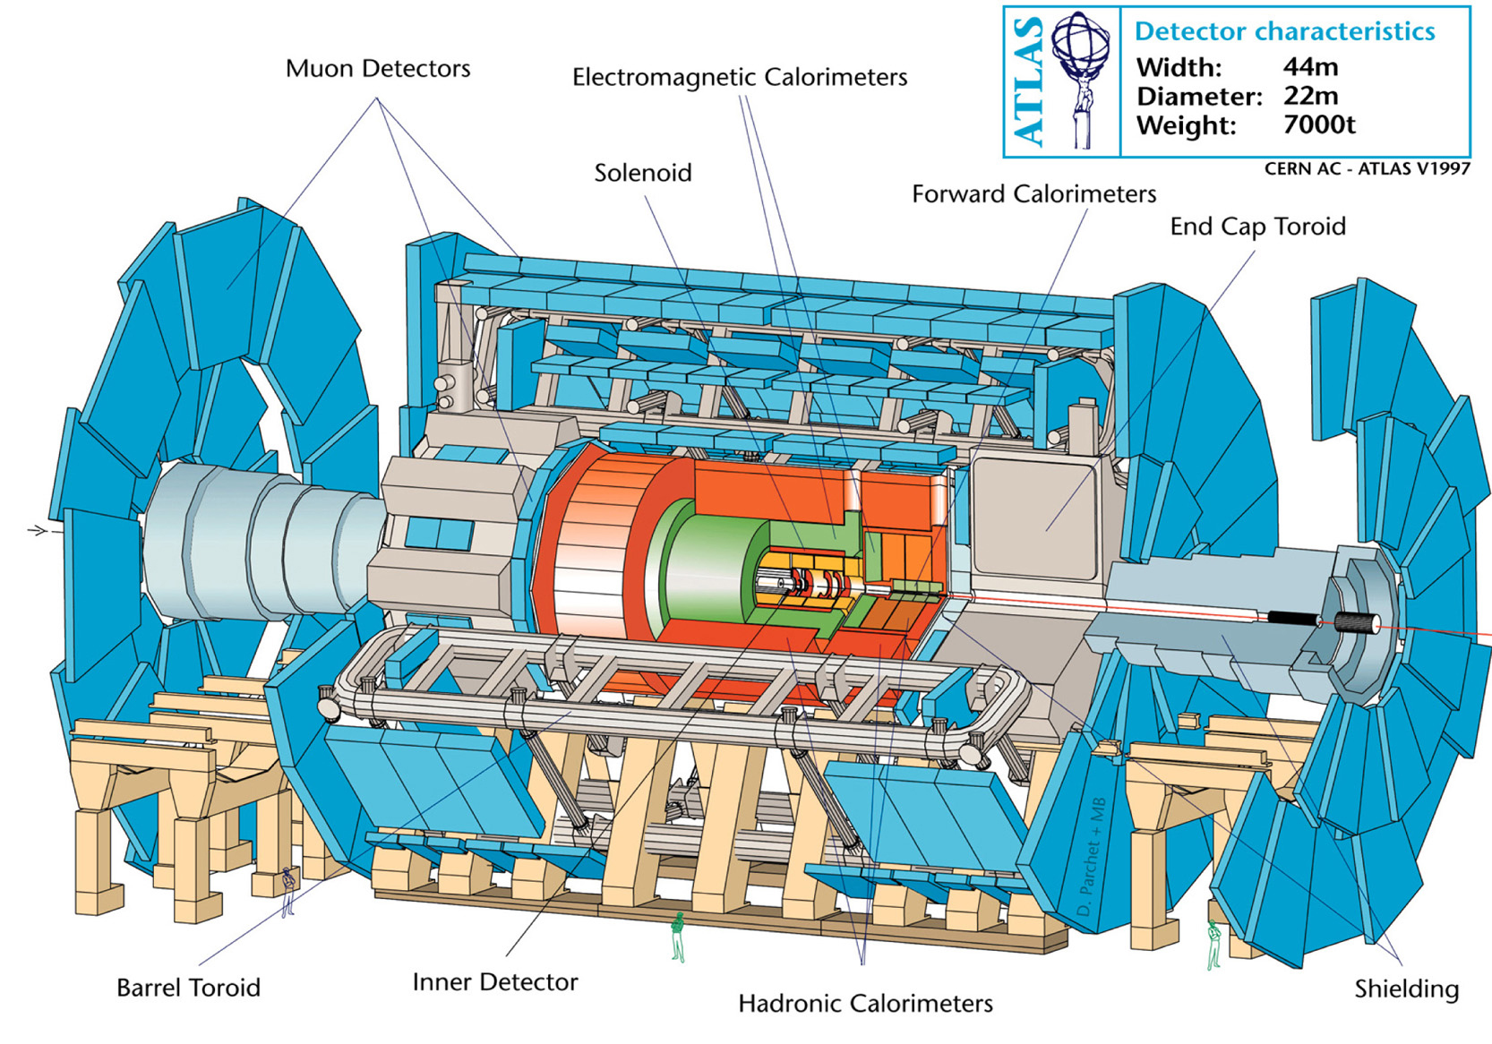
The ATLAS Detector at the Large Hadron Collider
1 billion collisions(events)/sec → 200 interesting events/sec
Source: ATLAS Outreach
Notes:
Add something about LHC and it’s size, what it does

Slide 5
Research Question
How much can generalized machine learning algorithms improve sensitivity in VLQ detection?
How can we separate VLQ (signal) from all other
physics events (background)?
Boosted Decision Tree Output

Slide 6


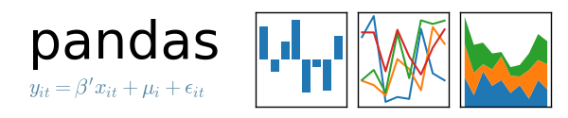


Methodology
Data Acquisition
(or Monte Carlo modeling)
Data Storage + analysis
Data Cleaning
Model development+ testing
Notes:
Explain that its MCMC trained

Slide 7
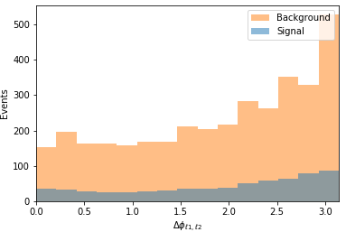
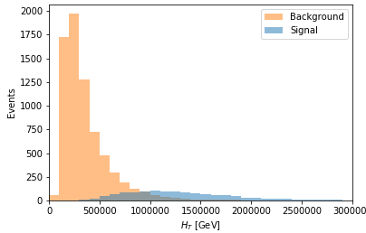
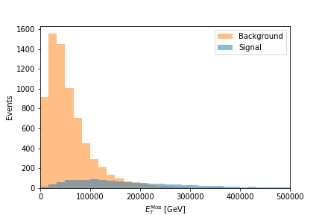
Feature Selection
𝚫φ_{𝓵1, 𝓵2}
H_{T}
Past experiments and current theories inform specific independent variables (features) to use (“feed”) in our models to best predict VLQ events
E_{T}^{Miss}

Slide 8
Evaluating ML Performance

Slide 9
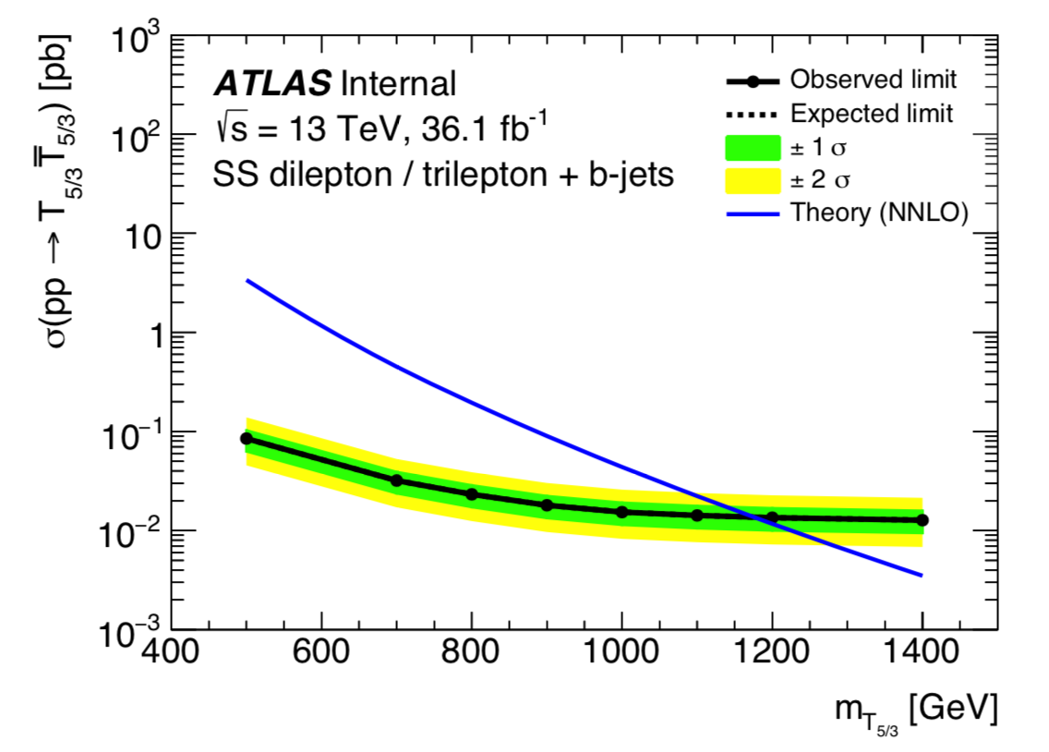
Next Steps and Future Efforts
Apply model to data to either find evidence for VLQ or put better limits on masses
Continue to tune algorithms to improve ML performance (precision!)
Fig 12: Current limits on VLQ mass (ATLAS Experiment)
Notes:
Apply to data and either find particle events or set limits on particle masses, continue to tune algorithms

Slide 10
Thank you

